Slide 1

Maple Leaf Nissan
Analysis of the Parts & Inventory System
and
Service Work Order System
by
Analysis performed by
Zenon Marsh, Aslam Mohammad,
and Josh Gravel

Slide 2
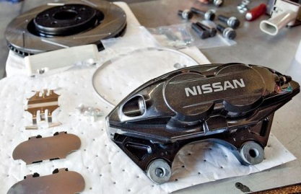
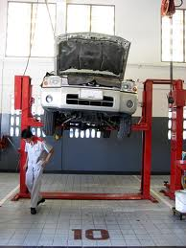


Table of Contents
Parts & Inventory System Analysis Parts Request Creating Order List/Purchase Orders Order Arrivals Customer Special Order Parts Return
Aslam is awesome
Service Work Order System Analysis
Creating Work Order Assigning Work Order Finalizing Work Order
Accounting Creating Purchase Order Number Compiling Customer Invoices
Shrinkage & Sales

Slide 3
Executive Summary
Maple Leaf Nissan has requested Revivify to perform an analysis on their Parts & Inventory and Service Work Order Systems. This report focuses on their current procedures and how they affect efficiency, customer satisfaction, and shrinkage.
Our study is segmented into different processes that we have identified through interviews, and by examining their everyday operations. The following documentation includes our findings.

Slide 4
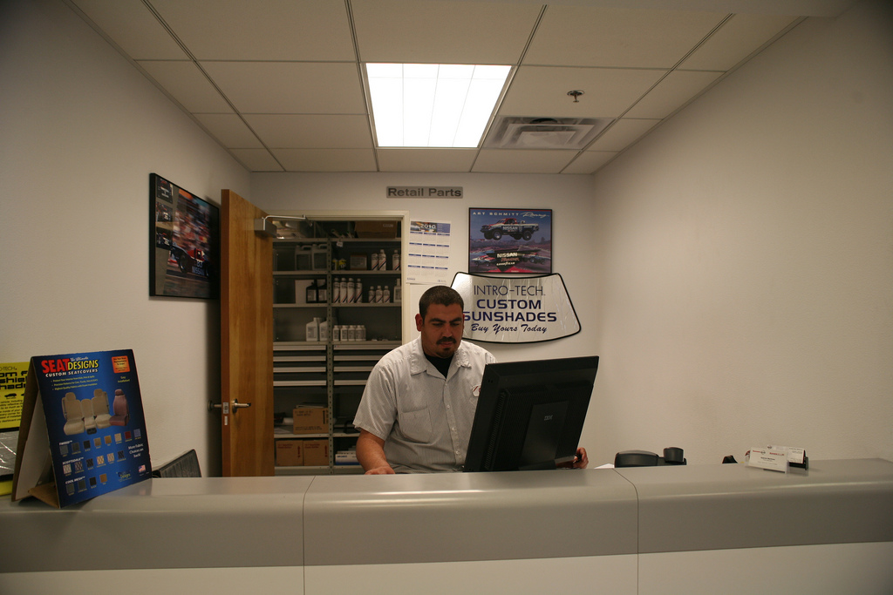
:Parts Request
Parts & Inventory System

Slide 5
:Parts Request
Parts & Inventory System
Parts Associates look up parts for Service Technicians and customers on the FAST system to identify the part
The Parts & Inventory System is then checked to see if there are any parts in stock
When parts are available they can sell the part to the customer, and give the customer an invoice. The inventory is updated after the invoice is finalized
Service Technicians are required to provide a Work Order to receive a part for service. The Parts Associate marks the part on the Work Order and the inventory is updated later after the service has been completed(See blah)
If parts are not currently available, the Parts Associate may put the part on special order

Slide 6
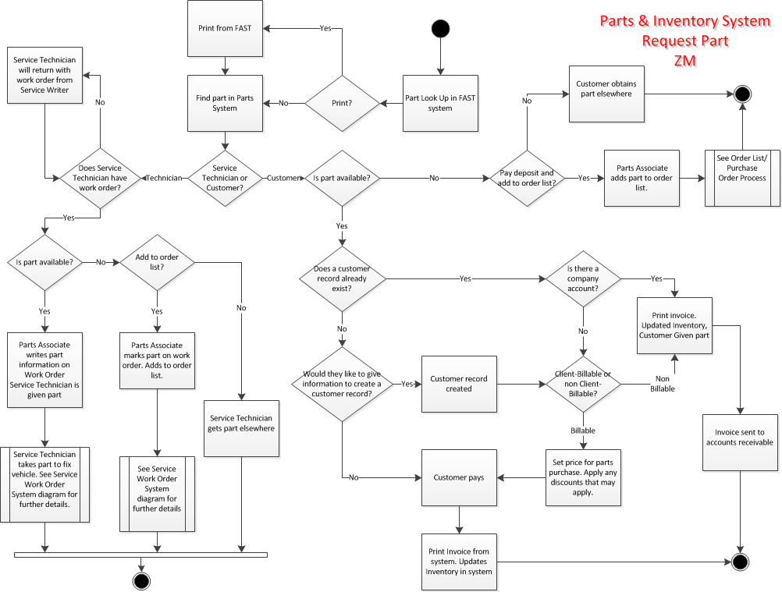
:Parts Request
Parts & Inventory System
Activity Diagram – See Page #

Slide 7
:Parts Request
Parts & Inventory System
Identified Problems:
Inventory is not updated immediately when a Service Technician requests a part from a Parts Associate to use in a service.
Special orders are kept on paper, and not always checked when going through new orders.
Customer numbers are not the same between the Parts & Inventory System and the Service Work Order system.
F.A.S.T and AllData systems not connected with Parts & Inventory System

Slide 8

:Order Lists/Purchase Orders
Parts & Inventory System

Slide 9
:Order Lists/Purchase Orders
Parts & Inventory System
Parts Associates add unavailable parts to order lists for customers or technicians
Parts Associates may add reorders to order lists
Parts & Service Manager contacts Business Manager to obtain Purchase Order Numbers
Purchase Orders are faxed to the chosen warehouse (generally the Regional Warehouse)

Slide 10
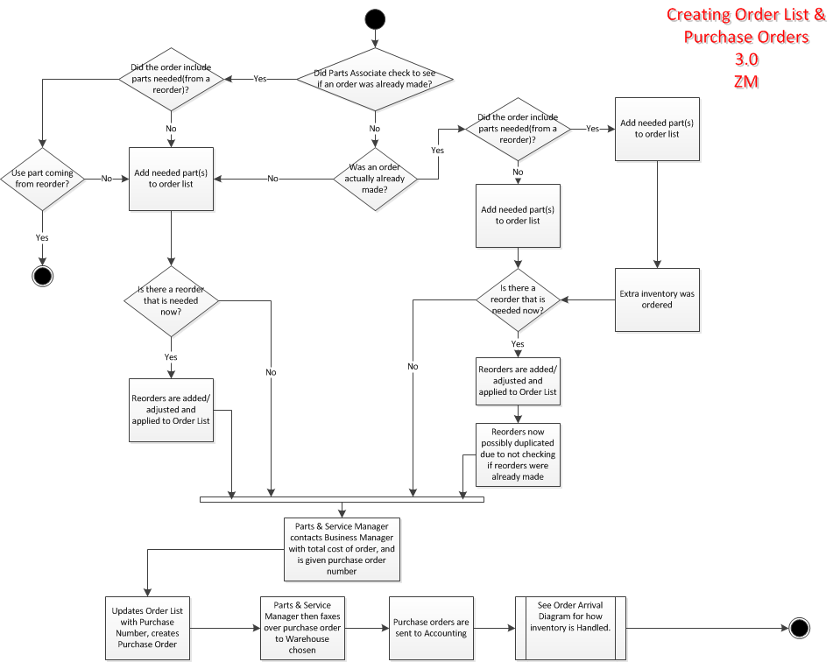
:Order Lists/Purchase Orders
Parts & Inventory System
Activity Diagram – See Page #

Slide 11
:Order Lists/Purchase Orders
Parts & Inventory System
Identified Problems:
Order history not easily accessible. Ex: Hard to check what parts and reorders have already been ordered. This can cause a part to be ordered when another is already coming in.
Inventory system does not remove flag from reorder even after reordered made, only when inventory is updated
Reorders can be duplicated
Parts that are commonly ordered are not tracked. Ex: If spark plugs are needed to be reordered multiple times per week, more shipments are needed. This could affect sales loss as well, if part is quite often out of stock, and customer does not want to wait for reorder.

Slide 12
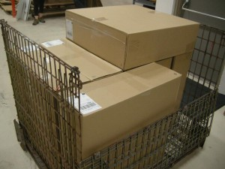
:Order Arrivals
Parts & Inventory System

Slide 13
:Order Arrivals
Parts & Inventory System
Shipments are received at Maple Leaf Nissan
Parts Associates compare the packing slip with the contents of the package
Inventory is updated in the Parts & Inventory system after contents are confirmed
Special customer orders can be set aside from regular inventory

Slide 14
:Order Arrivals
Parts & Inventory System

Slide 15
:Order Arrivals
Parts & Inventory System
Identified Problems:
Special orders are kept on paper, separate from the system
Special orders are not always checked
Customers are not always contacted to inform them of order arrival
Customers special order can be set aside, and then sold
Tracking outstanding shipments is difficult – must specifically have purchase order number to search, no history

Slide 16

:Customer Special Order
Parts & Inventory System

Slide 17
:Customer special order
Parts & Inventory System
Customers are contacted to retrieve their parts order
Customers pay the remainder of their bill (minus discounts paid)
Inventory Associates finalize, and invoices for customers

Slide 18
:Customer special order
Parts & Inventory System

Slide 19
:Customer special order
Parts & Inventory System
Identified Problems:
Customers are not always advised of when their part is available
Parts special ordered by customers can be sold by mistake
If part is not available for customer, it can cause the customer to go elsewhere

Slide 20

:Parts return
Parts & Inventory System

Slide 21
:Parts return
Parts & Inventory System

Slide 22
:Parts return
Parts & Inventory System
Identified Problems:
Returned part are not tracked specifically in the system
A Service Tech may use a newer part while working on an work order, instead of using the returned part first

Slide 23

:creating work order
Service Work Order System

Slide 24
:creating work order
Service Work Order System
Customers approach Service Writer for service
Customer explains issues to Service Writer
Service Writer creates a work order based on customers explanation of issue(s)
Service Writer may use the AllData system to pull standard rates for services
Work orders are signed by customer

Slide 25
:creating work order
Service Work Order System

Slide 26
:creating work order
Service Work Order System
Identified Problems:
AllData system not connected with Service Work Order System

Slide 27

:Assigning work order
Service Work Order System

Slide 28
:Assigning work order
Service Work Order System
The Service Writer gives a work order to a Service Technician
If it is a standard procedure, the Service Technician will work on the issue
Service Technicians work on issues until vehicle is fixed
If additional issues are identified, the Service Technician returns to the Service Writer and the Service Writer contacts the customer to request approval for further work
Service Technicians may go to a Parts Associate to request a part. The part is marked on their Work Order
When work is complete, the Service Technician returns the Work Order with the services performed and parts used

Slide 29
:Assigning work order
Service Work Order System

Slide 30
:Assigning work order
Service Work Order System
Identified Problems:
Service Technicians may be requested to write the part themselves on their work orders if Service Writer is too busy. If this is forgotten, part is given away, and inventory is off in the Parts & Inventory System
Service Writer must contact the Parts Associate periodically to check if part ordered is available. Not being aware of when the part is available can potentially cause delay of service

Slide 31
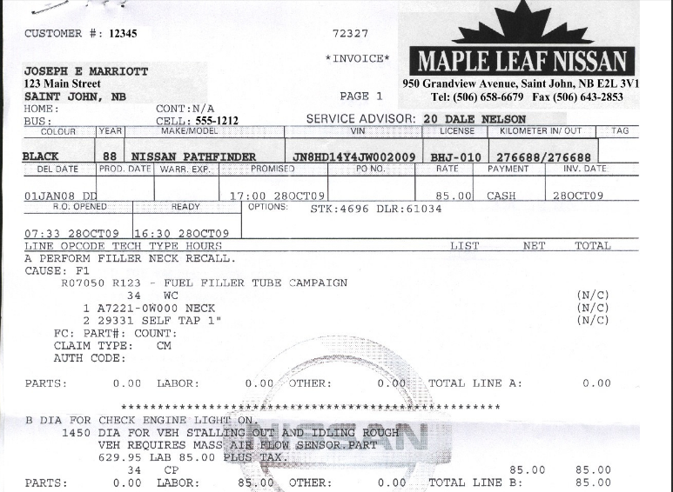
:Finalizing work order
Service Work Order System

Slide 32
:Finalizing work order
Service Work Order System
Service Writer determines if work is billable or not
The Service Writer includes the updates from the Service Technician on the Work Order, and turns it into an invoice in the system
Customer pays the Service Writer if billable
Service Writer prints an invoice for the customer. The inventory is updated with any parts used

Slide 33
:Finalizing work order
Service Work Order System

Slide 34
:Finalizing work order
Service Work Order System
Identified Problems:
Service Technicians time is not tracked

Slide 35

:purchase order numbers
Accounting

Slide 36
:purchase order numbers
Accounting
Parts & Service Manager contacts Business Manager for purchase order number(s)
Parts & Service Manager gives Business Manager the totals for the order

Slide 37
:purchase order numbers
Accounting

Slide 38
:purchase order numbers
Accounting
Identified Problems:
There is a concern that everything needs to be done over phone calls.
Has to sometimes track down invoices as they do not always make it to the Business Manager.
Multiple orders being processed for same item, missing out on discounts for bulk orders.

Slide 39
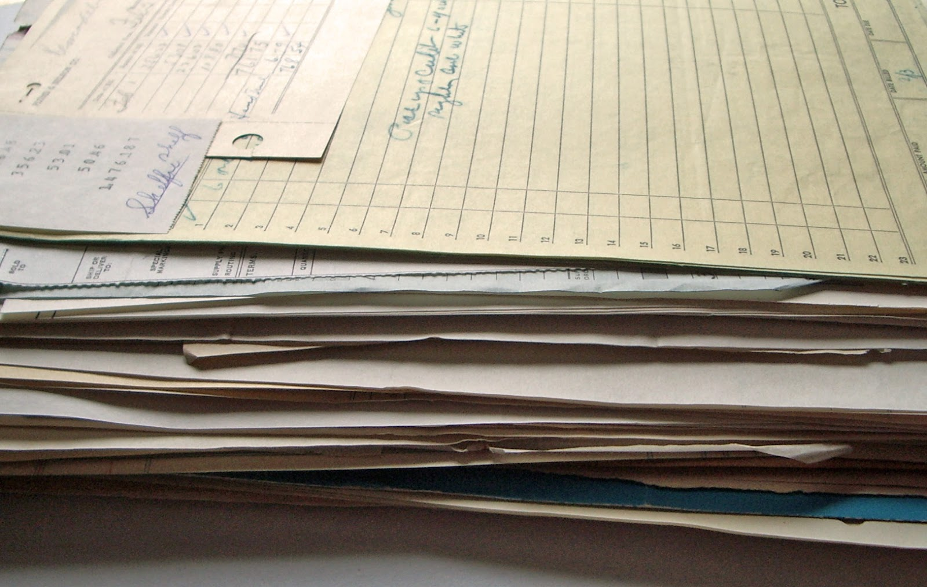
:Compiling customer invoices
Accounting

Slide 40
:Compiling customer invoices
Accounting
The Accountant takes invoices and enters the information into the accounting system
Any information regarding warranty, recalls, and discounts is accounted for

Slide 41
:Compiling customer invoices
Accounting

Slide 42
:Compiling customer invoices
Accounting
Identified Problems:
Customer invoices can be missing or illegible and can lead to inaccurate data
All data is entered manually into the accounting system, and this is time consuming

Slide 43

Shrinkage & Sales Loss

Slide 44
Shrinkage & Sales Loss
Analysis of procedures and how it affects Shrinkage
Analysis of customer satisfaction and how it affects Sales Loss
Please go to page 32

